Slide 1
Number systems: binary, decimal, hexadecimal and octal (Vice Versa).
Fixed and floating point representation & code converters

Slide 2
BINARY NUMBERS
The binary system is less complicated than the decimal system because it has only two digits, it is a base-two system. The two binary digits (bits) are 1 and 0. The position of a 1 or 0 in a binary number indicates its weight, or value within the number, just as the position of a decimal digit determines the value of that digit. The weights in a binary number are based on power of two as:
2⁰ + 2¹ + 2² + 2³ + …. + 2^{n}.
With 4 digits position we can count from zero to 15.In general, with n bits we can count up to a number equal to 2ⁿ - 1.
Largest decimal number = 2ⁿ - 1

Slide 3
Binary-to-Decimal Conversion
The decimal value of any binary number can be found by adding the weights of all bits that are 1 and discarding the weights of all bits that are 0.
Example
Let’s convert the binary whole number 101101 to decimal.
Binary no: 1 0 1 1 0 1
101101= 1*2^5 + 0*2^4 + 1*2^3 +1*2^2 + 0*2^1 + 1*2^0
= 32+8+4+1=45

Slide 4
Decimal Numbers
In the decimal number systems each of the ten digits, 0 through 9, represents a certain quantity. The position of each digit in a decimal number indicates the magnitude of the quantity represented and can be assigned a weight. The weights for whole numbers are positive powers of ten that increases from right to left, beginning with 10° = 1
…… 10 10 10³ 10² 10¹ 10°
For fractional numbers, the weights are negative powers of ten that decrease from left to right beginning with 10¯¹.
10² 10¹ 10° . 10¯¹ 10¯² 10¯³ ……..
The value of a decimal number is the sum of digits after each digit has been multiplied by its weights as in following examples.

Slide 5
1.Express the decimal number 87 as a sum of the values of each digit.
Solution: the digit 8 has a weight of 10, which is 10, as indicated by its position. The digit 7 has a weight of 1, which is 10º, as indicated by its position.
87 = (8 x 10) + (7 x 10^0) = (8 x 10) + (7 x 1) = 87
2.Express the decimal number 725.45 as a sum of the values of each digit.
725.45 = (7 x 10²) + (2 x 10¹) + (5 x 10º) + (4 x 10¯¹) +(5 x 10¯²)
725.45 = 700 + 20 + 5 + 0.4 + 0.05

Slide 6
Decimal number Binary number
0 0 0 0 0
1 0 0 0 1
2 0 0 1 0
3 0 0 1 1
4 0 1 0 0
5 0 1 0 1
6 0 1 1 0
7 0 1 1 1
8 1 0 0 0
9 1 0 0 1
10 1 0 1 0
11 1 0 1 1
12 1 1 0 0
13 1 1 0 1
14 1 1 1 0
15 1 1 1 1

Slide 7
Decimal-to-Binary Conversion
One way to find the binary number that is equivalent to a given decimal number is to determine the set of binary weights whose sum is equal to the decimal number. For example decimal number 9, can be expressed as the sum of binary weights as follows:
9 = 8 + 1 or 9 = 2³ + 2°
Placing 1s in the appropriate weight positions, 2³ and
2°, and 0s in the 2² and 2¹ positions determines the binary number for decimal 9.
2³ 2² 2¹ 2°
1 0 0 1 Binary number for nine

Slide 8
Hexadecimal numbers
The hexadecimal number system has sixteen digits and is used primarily as a compact way of displaying or writing binary numbers because it is very easy to convert between binary and hexadecimal. Long binary numbers are difficult to read and write because it is easy to drop or transpose a bit. Hexadecimal is widely used in computer and microprocessor applications. The hexadecimal system has a base of sixteen; it is composed of 16 digits and alphabetic characters.
The maximum 3-digits hexadecimal number is FFF or decimal 4095 and maximum 4-digit hexadecimal number is FFFF or decimal 65.535

Slide 9
Decimal Binary Hexadecimal
0 0000 0
1 0001 1
2 0010 2
3 0011 3
4 0100 4
5 0101 5
6 0110 6
7 0111 7
8 1000 8
9 1001 9
10 1010 A
11 1011 B
12 1100 C
13 1101 D
14 1110 E
15 1111 F

Slide 10
Binary-to-Hexadecimal Conversion
Simply break the binary number into 4-bit groups, starting at the right-most bit and replace each 4-bit group with the equivalent hexadecimal symbol as in the following example.
Convert the binary number to hexadecimal:
1100101001010111
Solution:
1100 1010 0101 0111
C A 5 7 = CA57

Slide 11
Hexadecimal-to-Decimal Conversion
One way to find the decimal equivalent of a hexadecimal number is to first convert the hexadecimal number to binary and then convert from binary to decimal.
Convert the hexadecimal number 1C to decimal:
1 C
0001 1100 = (2^4) +(2^3) +(2^2) = 28

Slide 12
Decimal-to-Hexadecimal Conversion
Repeated division of a decimal number by 16 will produce the equivalent hexadecimal number, formed by the remainders of the divisions. The first remainder produced is the least significant digit (LSD). Each successive division by 16 yields a remainder that becomes a digit in the equivalent hexadecimal number. When a quotient has a fractional part, the fractional part is multiplied by the divisor to get the remainder.
Convert the decimal number 650 to hexadecimal by repeated division by 16.
  650 = 40.625 0.625 x 16 = 10 = A (LSD)
  40 = 2.5 0.5 x 16 = 8 = 8
  2 = 0.125 0.125 x 16 = 2 = 2 (MSD)
  The hexadecimal number is 28A

Slide 13
Octal Numbers
Like the hexadecimal system, the octal system provides a convenient way to express binary numbers and codes.
However, it is used less frequently than hexadecimal in conjunction with computers and microprocessors to express binary quantities for input and output purposes.
The octal system is composed of eight digits, which are:
0, 1, 2, 3, 4, 5, 6, 7
To count above 7, begin another column and start over:
10, 11, 12, 13, 14, 15, 16, 17, 20, 21 and so on.
Counting in octal is similar to counting in decimal, except that the digits 8 and 9 are not used.

Slide 14
Octal-to-Decimal Conversion
Since the octal number system has a base of eight, each successive digit position is an increasing power of eight, beginning in the right-most column with 8º. The evaluation
Of an octal number in terms of its decimal equivalent is accomplished by multiplying each digit by its weight and summing the products.
Let’s convert octal number 2374 in decimal number.
Weight 8³ 8² 8¹ 8°
Octal number 2 3 7 4
2374 = (2 x 8³) + (3 x 8²) + (7 x 8¹) + (4 x 8°)=1276

Slide 15
Decimal-to-Octal Conversion
A method of converting a decimal number to an octal number is the repeated division-by-8 method, which is similar to the method used in the conversion of decimal numbers to binary or to hexadecimal.
Let’s convert the decimal number 359 to octal. Each successive division by 8 yields a remainder that becomes a digit in the equivalent octal number. The first remainder generated is the least significant digit (LSD).
359 = 44.875 0.875 x 8 = 7 (LSD)
44 = 5.5 0.5 x 8 = 4
5 = 0.625 0.625 x 8 = 5 (MSD)
The number is 547.

Slide 16
Octal-to-Binary Conversion
Because each octal digit can be represented by a 3-bit binary number, it is very easy to convert from octal to binary..
Octal/Binary Conversion
Octal Digit 0 1 2 3 4 5 6 7
Binary 000 001 010 011 100 101 110 111
Let’s convert the octal numbers 25 and 140.
2 5 1 4 0
010 101 001 100 000

Slide 17
Binary-to-Octal Conversion
Conversion of a binary number to an octal number is the reverse of the octal-to-binary conversion.
Let’s convert the following binary numbers to octal:
1 1 0 1 0 1 1 0 1 1 1 1 0 0 1
6 5 = 65 5 7 1 = 571

Slide 18
Unsigned representation
An unsigned integer is an integer that can never be negative and can take only 0 or positive values. Its range is between 0 and positive infinity.
0 → (2^{n} -1)
An input device stores an unsigned integer using the following steps:
The integer is changed to binary.
If the number of bits is less than n, 0s are added to the left.

Slide 19
Sign-and-magnitude representation
In this method, the available range for unsigned integers (0 to 2^{n} − 1) is divided into two equal sub-ranges. The first half represents positive integers, the second half, negative integers.
Sign-and-magnitude representation
Note that we have two 0s: positive zero and negative zero.
Range: - (2^{n-1} -1) to (2^{n-1} -1)
In sign-and-magnitude representation, the leftmost bit defines the sign of the integer. If it is 0, the integer is positive. If it is 1, the integer is negative.

Slide 20
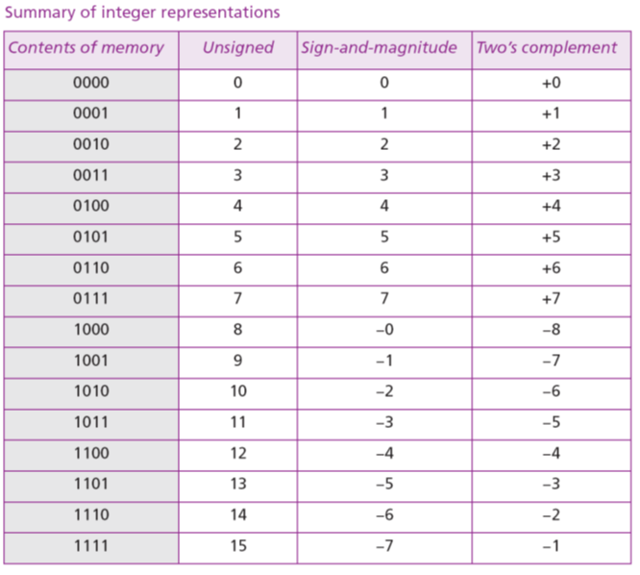

Slide 21
Storage of IEEE standard floating point numbers:
    Store the sign in S (0 or 1).
    Change the number to binary.
    Normalize.
    Find the values of E and M.
    Concatenate S, E, and M.

Slide 22
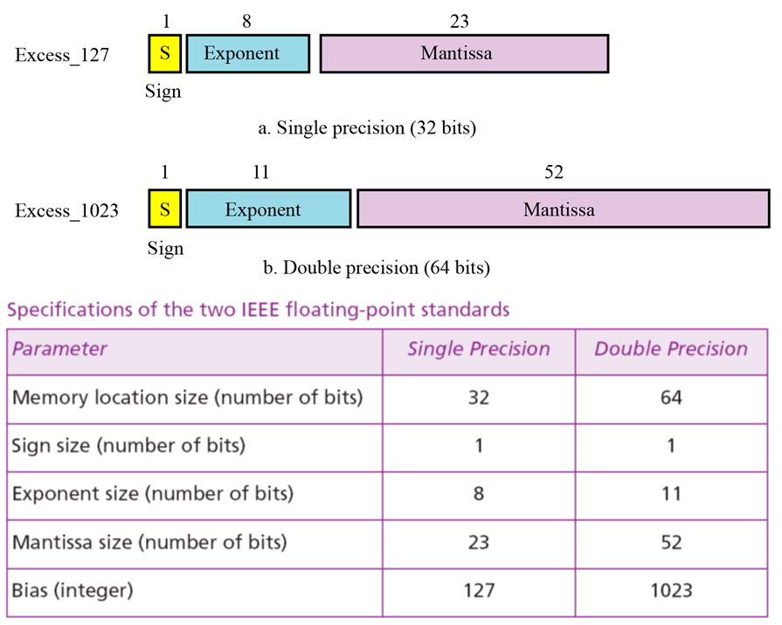

Slide 23
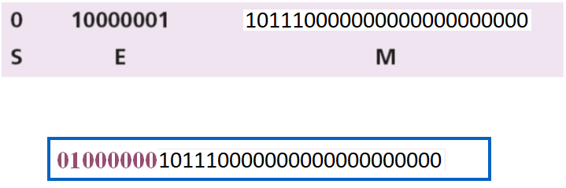
Show the Excess_127 (single precision) representation of the decimal number 5.75.
The sign is positive, so S = 0.
Decimal to binary transformation: 5.75 = (101.11)₂.
Normalization: (101.11)₂ = (1.0111)₂ × 2².
E = 2 + 127 = 129 = (10000001)₂, M = 1011. We need to add nineteen zeros at the right of M to make it 23 bits.
The presentation is shown below:

Slide 24
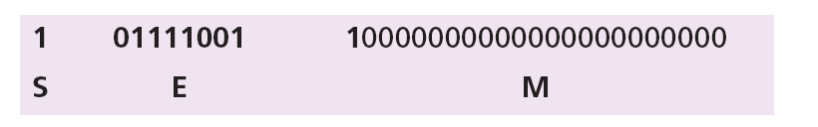
Show the Excess_127 (single precision) representation of the decimal number –0.0234375.
S = 1 (the number is negative).
Decimal to binary transformation: 0.0234375 = (0.0000011)₂.
Normalization: (0.0000011)₂ = (1.1)₂ × 2⁻⁶.
E = –6 + 127 = 121 = (01111001)₂ and M = (1)₂.
Representation:
10111100110000000000000000000000

Slide 25
Retrieving numbers stored in IEEE standard floating point format:
  Find the value of S,E, and M.
  If S=0, set the sign to positive, otherwise set the sign to negative.
  Find the shifter (E-127).
  Denormalize the mantissa.
  Change the Denormalize number to binary to find the absolute value.
  Add the sign.

Slide 26
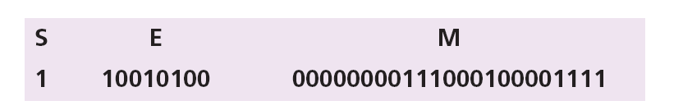
The bit pattern (11001010000000000111000100001111)₂ is stored in Excess_127 format. Show the value in decimal.
The first bit represents S, the next eight bits, E and the remaining 23 bits, M.
The sign is negative.
The shifter = E − 127 = 148 − 127 = 21.
This gives us (1.00000000111000100001111)₂ × 2²¹.
The binary number is (1000000001110001000011.11)₂.
The absolute value is 2,104,378.75.
The number is −2,104,378.75.

Slide 27
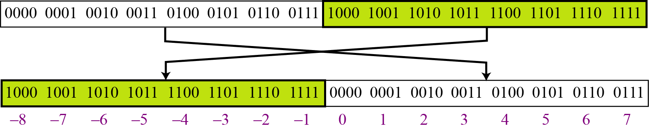
Two’s complement representation
Almost all computers use two’s complement representation to store a signed integer in an n-bit memory location. In this method, the available range for an unsigned integer of (0 to 2n − 1) is divided into two equal sub-ranges. The first sub-range is used to represent nonnegative integers, the second half to represent negative integers. The bit patterns are then assigned to negative and nonnegative (zero and positive) integers as shown
Two’s complement representation

Slide 28
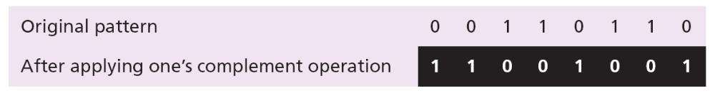
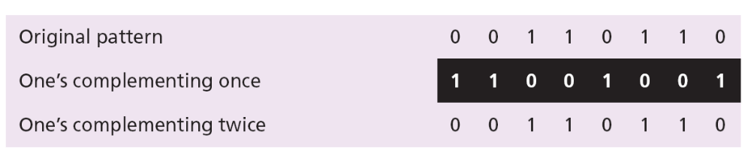
One’s Complementing
The operation can be applied to any integer, positive or negative. This operation simply reverses (flips) each bit. A 0-bit is changed to a 1-bit, a 1-bit is changed to a 0-bit.
The following shows how we take the one’s complement of the integer 00110110.
The following shows that we get the original integer if we apply the one’s complement operations twice.

Slide 29
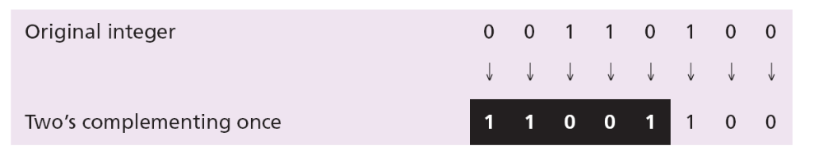
Two’s Complementing
This operation is done in two steps. First, we copy bits from the right until a 1 is copied; then, we flip the rest of the bits.
The following shows how we take the two’s complement of the integer 00110100.

Slide 30
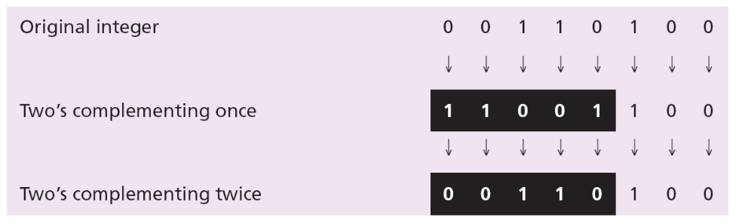
The following shows that we always get the original integer if we apply the two’s complement operation twice.
An alternative way to take the two’s complement of an integer is to first take the one’s complement and then add 1 to the result.

Slide 31
Store the integer 28 in an 8-bit memory location using two’s complement representation.
Solution
The integer is positive (no sign means positive), so after decimal to binary transformation no more action is needed. Note that five extra 0s are added to the left of the integer to make it eight bits.

Slide 32
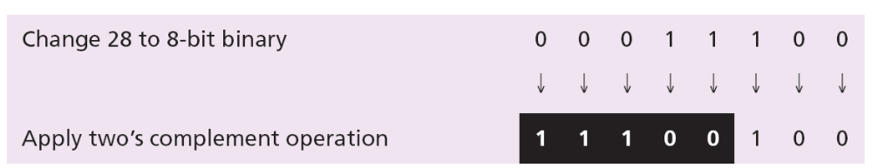
Store −28 in an 8-bit memory location using two’s complement representation.
Solution
The integer is negative, so after changing to binary, the computer applies the two’s complement operation on the integer.

Slide 33
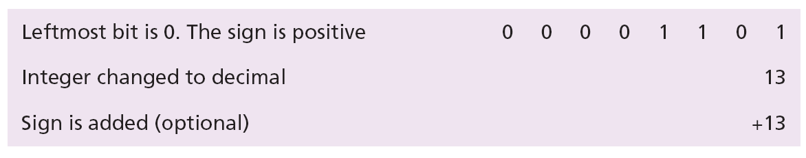
Retrieve the integer that is stored as 00001101 in memory in two’s complement format.
Solution
The leftmost bit is 0, so the sign is positive. The integer is changed to decimal and the sign is added.

Slide 34
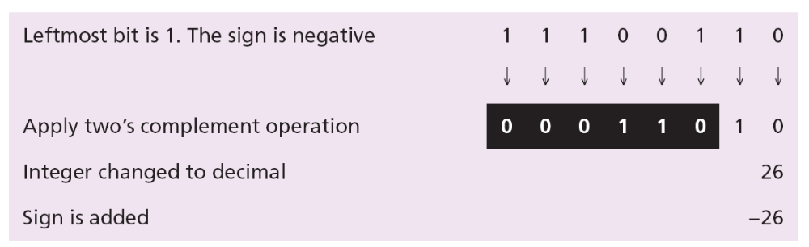
Retrieve the integer that is stored as 11100110 in memory using two’s complement format.
Solution
The leftmost bit is 1, so the integer is negative. The integer needs to be two’s complemented before changing to decimal.

Slide 35
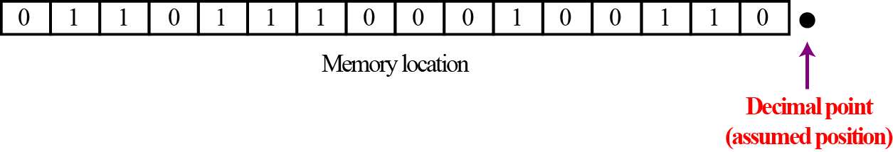
Need of Fixed point representation
Integers are whole numbers (numbers without a fractional part). For example, 134 and −125 are integers, whereas 134.23 and −0.235 are not. An integer can be thought of as a number in which the position of the decimal point is fixed: the decimal point is to the right of the least significant (rightmost) bit. For this reason, fixed-point representation is used to store an integer, as shown in Figure below In this representation the decimal point is assumed but not stored.
Note: For the decimal point, computers use two different representations: fixed-point and floating-point. The first is used to store a number as an integer- without a fraction part, the second is used to store a number as a real- with a fractional part.

Slide 36
A real is a number with an integral part and a fractional part. For example, 23.7 is a real number—the integral part is 23 and the fractional part is 7/10. Although a fixed-point representation can be used to represent a real number, the result may not be accurate or it may not have the required precision. The next two examples explain why.
Real numbers with very large integral parts or very small fractional parts should not be stored in fixed-point representation.

Slide 37
Example 1
In the decimal system, assume that we use a fixed-point representation with two digits at the right of the decimal point and fourteen digits at the left of the decimal point, for a total of sixteen digits. The precision of a real number in this system is lost if we try to represent a decimal number such as 1.00234: the system stores the number as 1.00.
Example 2
In the decimal system, assume that we use a fixed-point representation with six digits to the right of the decimal point and ten digits for the left of the decimal point, for a total of sixteen digits. The accuracy of a real number in this system is lost if we try to represent a decimal number such as 236154302345.00. The system stores the number as 6154302345.00: the integral part is much smaller than it should be.

Slide 38
What is meant by code?
The digital data is represented, stored and transmitted as group of binary bits. This group is also called as binary code. The binary code is represented by the number as well as alphanumeric letter.
Codes are classified in to 2 types
Weighted
Non-weighted

Slide 39
WEIGHTED CODE
In weighted code, each digit position has a weight or value.
The sum of all digits multiplied by a weight gives a total amount being represented.
BCD or 8421 is a type of weighted code where each digit position is assigned a specific weight.
NON WEIGHTED CODE
In non weighted code there is no positional weight
i.e., Each position within the binary number is not assigned a prefix value.
No specific positions are assigned to bit positions in non weighted code.
The non weighted codes are (1) Gray code (2) Excess-3 code.

Slide 40
Code converters
Code conversion is used to change the data present in one type of binary code to another type of binary code. Some of the codes are BCD, Gray, Excess 3, ASCII and so on.
Some of the conversions are
Binary to Gray code conversion
Gray to Binary code conversion
BCD to Excess-3 code conversion
Excess-3 to BCD code conversion

Slide 41
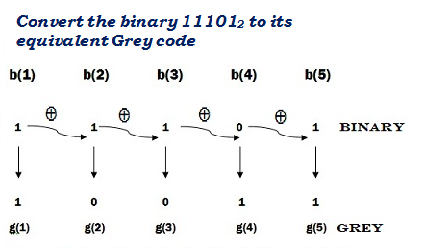
Binary to Gray code conversion
The Gray code is non-weighted code, as the position of bit does not contain any weight. The Gray code is a reflective digital code which has the special property that any two subsequent numbers codes differ by only one bit. This is also called a unit- distance code.
The generation of 4-bit Gray code can be calculated by using formula.
G₁ = Β₁
G₂ = Β₁⊕Β₂
G₃ = Β₂⊕Β₃
G₄ = Β₃⊕Β₄

Slide 42
A four-bit binary to Gray code conversion table is as shown below.
Four Bit Binary Number |  |  |  | Four Bit Gray Code
B₁ | B₂ | B₃ | B₄ | G₁ | G₂ | G₃ | G₄
0 | 0 | 0 | 0 | 0 | 0 | 0 | 0
0 | 0 | 0 | 1 | 0 | 0 | 0 | 1
0 | 0 | 1 | 0 | 0 | 0 | 1 | 1
0 | 0 | 1 | 1 | 0 | 0 | 1 | 0
0 | 1 | 0 | 0 | 0 | 1 | 1 | 0
0 | 1 | 0 | 1 | 0 | 1 | 1 | 1
0 | 1 | 1 | 0 | 0 | 1 | 0 | 1
0 | 1 | 1 | 1 | 0 | 1 | 0 | 0
1 | 0 | 0 | 0 | 1 | 1 | 0 | 0
1 | 0 | 0 | 1 | 1 | 1 | 0 | 1
1 | 0 | 1 | 0 | 1 | 1 | 1 | 1
1 | 0 | 1 | 1 | 1 | 1 | 1 | 0
1 | 1 | 0 | 0 | 1 | 0 | 1 | 0
1 | 1 | 0 | 1 | 1 | 0 | 1 | 1
1 | 1 | 1 | 0 | 1 | 0 | 0 | 1
1 | 1 | 1 | 1 | 1 | 0 | 0 | 0

Slide 43
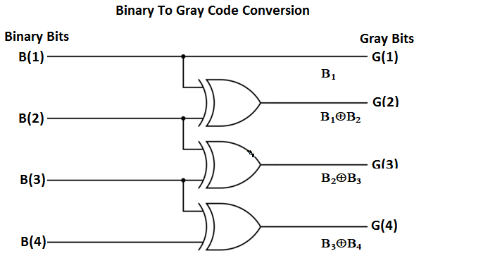
The circuit for Binary to Gray code conversion is

Slide 44
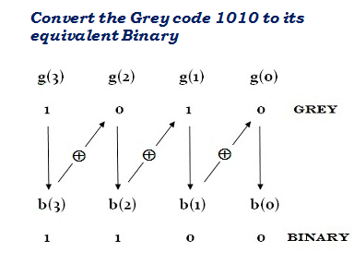
Gray to binary code conversion
In Gray to binary conversion, the input is Gray code and output is its equivalent binary code.
The generation of four-bit binary equivalent code can be calculated by using formula.
Β₁ = G₁
Β₂ = G₂ ⊕ Β₁
Β₃ = G₃ ⊕ Β₂
Β₄ = G₄ ⊕ Β₃
The MSB of binary code is similar to the MSB of Gray code.
To get next bit, use the ex-oring operation among the MSB of binary to the next bit of the Gray code.
Similarly, to get the third bit, it uses the ex-oring operation among the second bit to the third MSB of the Gray code and so on.

Slide 45
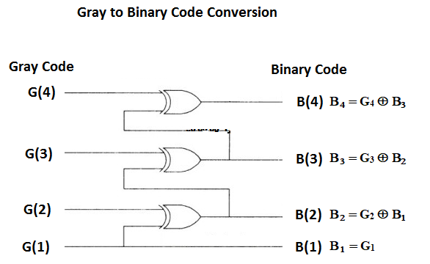
The Gray to binary conversion method can be done by using ex-oring logic gate.
A four-bit Gray to binary code converter is as shown below.

Slide 46
A four-bit Gray to binary code conversion table is as shown below.
Four Bit Gray Code |  |  |  | Four Bit Binary Number
G₁ | G₂ | G₃ | G₄ | B₁ | B₂ | B₃ | B₄
0 | 0 | 0 | 0 | 0 | 0 | 0 | 0
0 | 0 | 0 | 1 | 0 | 0 | 0 | 1
0 | 0 | 1 | 1 | 0 | 0 | 1 | 0
0 | 0 | 1 | 0 | 0 | 0 | 1 | 1
0 | 1 | 1 | 0 | 0 | 1 | 0 | 0
0 | 1 | 1 | 1 | 0 | 1 | 0 | 1
0 | 1 | 0 | 1 | 0 | 1 | 1 | 0
0 | 1 | 0 | 0 | 0 | 1 | 1 | 1
1 | 1 | 0 | 0 | 1 | 0 | 0 | 0
1 | 1 | 0 | 1 | 1 | 0 | 0 | 1
1 | 1 | 1 | 1 | 1 | 0 | 1 | 0
1 | 1 | 1 | 0 | 1 | 0 | 1 | 1
1 | 0 | 1 | 0 | 1 | 1 | 0 | 0
1 | 0 | 1 | 1 | 1 | 1 | 0 | 1
1 | 0 | 0 | 1 | 1 | 1 | 1 | 0
1 | 0 | 0 | 0 | 1 | 1 | 1 | 1

Slide 47
BCD to Excess 3 code
Excess-3 codes are unweighted and can be obtained by adding 3 to each decimal digit then it can be represented by using 4-bit binary number for each digit.
To find the decimal equivalent of the given binary number. Add 0011 to each four-bit group in binary coded decimal number (BCD) to get desired excess-3 equivalent.
The variables B₀, B₁, B₂, and B₃ represent the bits of the binary numbers.
The variable 'B₀' represents the LSB, and the variable 'B₃' represents the MSB.
The variables E₀, E₁, E₂, and E₃ represent the bits of the Excess-3 code.
The variable 'E₀' represents the LSB, and the variable 'E₃' represents the MSB.

Slide 48
The truth table for BCD to Excess-3 code converter can be determined as shown in table below.
For impossible four bit Excess-3 code we use output as Don’t care conditions. The 'don't care conditions' is defined by the variable 'X'.
 | BCD Number |  |  |  | Excess-3 Code Number
Decimal | B₃ | B₂ | B₁ | B₀ | E₃ | E₂ | E₁ | E₀
0 | 0 | 0 | 0 | 0 | 0 | 0 | 1 | 1
1 | 0 | 0 | 0 | 1 | 0 | 1 | 0 | 0
2 | 0 | 0 | 1 | 0 | 0 | 1 | 0 | 1
3 | 0 | 0 | 1 | 1 | 0 | 1 | 1 | 0
4 | 0 | 1 | 0 | 0 | 0 | 1 | 1 | 1
5 | 0 | 1 | 0 | 1 | 1 | 0 | 0 | 0
6 | 0 | 1 | 1 | 0 | 1 | 0 | 0 | 1
7 | 0 | 1 | 1 | 1 | 1 | 0 | 1 | 0
8 | 1 | 0 | 0 | 0 | 1 | 0 | 1 | 1
9 | 1 | 0 | 0 | 1 | 1 | 1 | 0 | 0

Slide 49
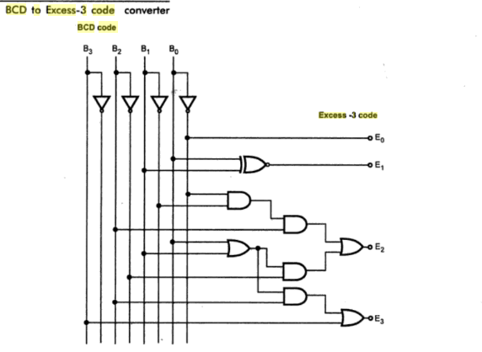
The circuit diagram for BCD to Excess-3 code converter is shown below

Slide 50
Excess-3 to BCD converter
The process of converting Excess-3 to BCD is opposite to the process of converting BCD to Excess-3.
The BCD code can be calculated by subtracting 3, i.e., 0011 from each four-digit Excess-3 code.
The variables E₀, E₁, E₂, and E₃ represent the bits of the Excess-3 code.
The variable 'E₀' represents the LSB, and the variable 'E₃' represents the MSB.
The variables B₀, B₁, B₂, and B₃ represent the bits of the binary numbers.
The variable 'B₀' represents the LSB, and the variable 'B₃' represents the MSB.
The 'don't care conditions' is defined by the variable 'X'.

Slide 51
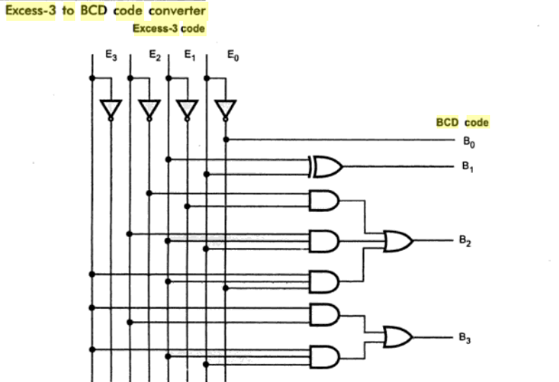
The circuit diagram for Excess-3 code to BCD converter is shown below

Slide 52
The truth table for BCD to Excess-3 code converter can be determined as shown in table below.
 | Excess-3 Code Number |  |  |  | BCD Number
Decimal | E₃ | E₂ | E₁ | E₀ | B₃ | B₂ | B₁ | B₀
0 | 0 | 0 | 1 | 1 | 0 | 0 | 0 | 0
1 | 0 | 1 | 0 | 0 | 0 | 0 | 0 | 1
2 | 0 | 1 | 0 | 1 | 0 | 0 | 1 | 0
3 | 0 | 1 | 1 | 0 | 0 | 0 | 1 | 1
4 | 0 | 1 | 1 | 1 | 0 | 1 | 0 | 0
5 | 1 | 0 | 0 | 0 | 0 | 1 | 0 | 1
6 | 1 | 0 | 0 | 1 | 0 | 1 | 1 | 0
7 | 1 | 0 | 1 | 0 | 0 | 1 | 1 | 1
8 | 1 | 0 | 1 | 1 | 1 | 0 | 0 | 0
9 | 1 | 1 | 0 | 0 | 1 | 0 | 0 | 1

